Slide 1
Fluid Dynamics
Or a Study of Our Waining Motivations
Andrew Palmer and Brian Liao

Slide 2

The Navier-Stokes Equation
In our Fluid Dynamics unit, we studied incompressible, non-viscous, non-turbulent fluid flow
What if we want to study viscous, turbulent (intresting) fluids? Enter vector calculus!
$$\frac{∂\vec{v}}{∂t}+\vec{v}∗div\left(\vec{v}\right)=−\left(\frac{1}{ρ}\right)grad\left(P\right)+\frac{μ}{ρ}div\left(grad\left(\vec{v}\right)\right)+\vec{f}$$
Variables:
$\vec{v}$: velocity vector field (also $\vec{u}$) (remember the electric field?)
$t$: time
$ρ$: density
$P$: pressure field (remember the voltage field?)
$μ$: viscosity
$\vec{f}$: force vector field

Slide 3
Navier-Stokes Equation Expanded Out
$\frac{∂v_{x}}{∂t}+v_{x}\frac{∂v_{x}}{∂x}+v_{y}\frac{∂v_{x}}{∂y}+v_{z}\frac{∂v_{x}}{∂z}=−\left(\frac{1}{ρ}\right)\frac{∂P}{∂x}+\frac{μ}{ρ}(\frac{∂^{2}v_{x}}{{∂x}^{2}}+\frac{∂^{2}v_{x}}{{∂y}^{2}}+\frac{∂^{2}v_{x}}{{∂z}^{2}})+f_{x}$
$\frac{∂v_{y}}{∂t}+v_{x}\frac{∂v_{y}}{∂x}+v_{y}\frac{∂v_{y}}{∂y}+v_{z}\frac{∂v_{y}}{∂z}=−\left(\frac{1}{ρ}\right)\frac{∂P}{∂y}+\frac{μ}{ρ}(\frac{∂^{2}v_{y}}{{∂x}^{2}}+\frac{∂^{2}v_{y}}{{∂y}^{2}}+\frac{∂^{2}v_{y}}{{∂z}^{2}})+f_{y}$
$\frac{∂v_{z}}{∂t}+v_{x}\frac{∂v_{z}}{∂x}+v_{y}\frac{∂v_{z}}{∂y}+v_{z}\frac{∂v_{z}}{∂z}=−\left(\frac{1}{ρ}\right)\frac{∂P}{∂z}+\frac{μ}{ρ}(\frac{∂^{2}v_{z}}{{∂x}^{2}}+\frac{∂^{2}v_{z}}{{∂y}^{2}}+\frac{∂^{2}v_{z}}{{∂z}^{2}})+f_{z}$
$\frac{∂v_{x}}{∂x}+\frac{∂v_{x}}{∂y}+\frac{∂v_{x}}{∂z}=0$

Slide 4

Explanation
$$\frac{∂\vec{v}}{∂t}+\vec{v}∗div\left(\vec{v}\right)=−\left(\frac{1}{ρ}\right)grad\left(P\right)+\frac{μ}{ρ}grad\left(div\left(\vec{v}\right)\right)+\vec{f}$$
Operators:
$\frac{∂\vec{v}}{∂t}$: Partial derivative of velocity vector field with respect to time, $〈\frac{∂v_{x}}{∂t}, \frac{∂v_{y}}{∂t}, \frac{∂v_{z}}{∂t}〉$
$div\left(\vec{v}\right)$: Divergence of velocity vector field, gives the scalar, $\frac{∂v_{x}}{∂x}+\frac{∂v_{y}}{∂y}+\frac{∂v_{z}}{∂z}$
Divergence is can be though of like how much the vector field is squishing towards that point
$grad\left(P\right)$: Gradient of pressure field, gives the vector, $〈\frac{∂P}{∂x}, \frac{∂P}{∂y}, \frac{∂P}{∂z}〉$
Think of the gradient like the simplest vector analog of a classic derivative. It’s the direction the function is increasing
$grad\left(div\left(\vec{v}\right)\right)$: Laplacian of velocity vector field $=\frac{∂^{2}v_{x}}{{∂x}^{2}}+\frac{∂^{2}v_{y}}{{∂y}^{2}}$+$\frac{∂^{2}v_{z}}{{∂z}^{2}}$
A vector second derivative. The direction the vector field is squashing towards?
Come to our Calculus BC presentation for more fun vector calculus with notation that isn’t nerfed

Slide 5

Explanation
$$ρ\left[\frac{∂\vec{v}}{∂t}+\vec{v}∗div\left(\vec{v}\right)\right]=−grad\left(P\right)+μ∗grad\left(div\left(\vec{v}\right)\right)+ρ∗\vec{f}$$
$\frac{∂\vec{v}}{∂t}+\vec{v}∗div\left(\vec{v}\right)$
This term gives the acceleration of the infinitesimal pieces of fluid
Notably this is not $\frac{∂\vec{v}}{∂t}$, which would be the acceleration in a particular spot in the volume
$−grad(P)$
This term represents the internal force in the fluid due to pressure
Remember $PA=F$, imagine making $A$ infinitesimal
$μ∗grad\left(div\left(\vec{v}\right)\right)$
This term represents the internal forces in the fluid due to the viscosity, which is like internal friction
Look it’s a funky version of $ma=F$!

Slide 6

Pressure
The Navier-Stokes equation is almost enough to solve alone, but we need to find an equation for the pressure
Luckily we have already assumed that $div\left(\vec{v}\right)=0$by saying our fluid is incompressible
So if we take the divergence of the Navier-Stokes equations and use some vector calculus, we can obtain the equation $grad\left(div\left(P\right)\right)=RHS$
The right hand side is just gnarly results from vector calculus
This is interesting because it is a Poisson equation which shows up fairly frequently in physics
Alternatively, we can use another vector calculus derivative, the curl, to totally eliminate the pressure if we do not care about it

Slide 7

Analytical Solutions of Navier-Stokes?
An open problem in Mathematics!
Navier-Stokes existence and smoothness, a Millennium Prize Problem with a $1,000,000 award for solution.
Solve:
Existence and smoothness of the Navier–Stokes solutions in $ℝ^{3}$
Breakdown of the Navier–Stokes solution in $ℝ^{3}$
Existence and smoothness of Navier–Stokes solutions in $ℝ^{3}/ℤ^{3}$
Breakdown of the Navier–Stokes solutions in $ℝ^{3}/ℤ^{3}$
Terence Tao has shown finite time blow up for the averaged 3D Navier-Stokes equation and has hypothesized a solution using a self-replicating Von-Neumnann machine fluid computer that would be able to show blow up.

Slide 8
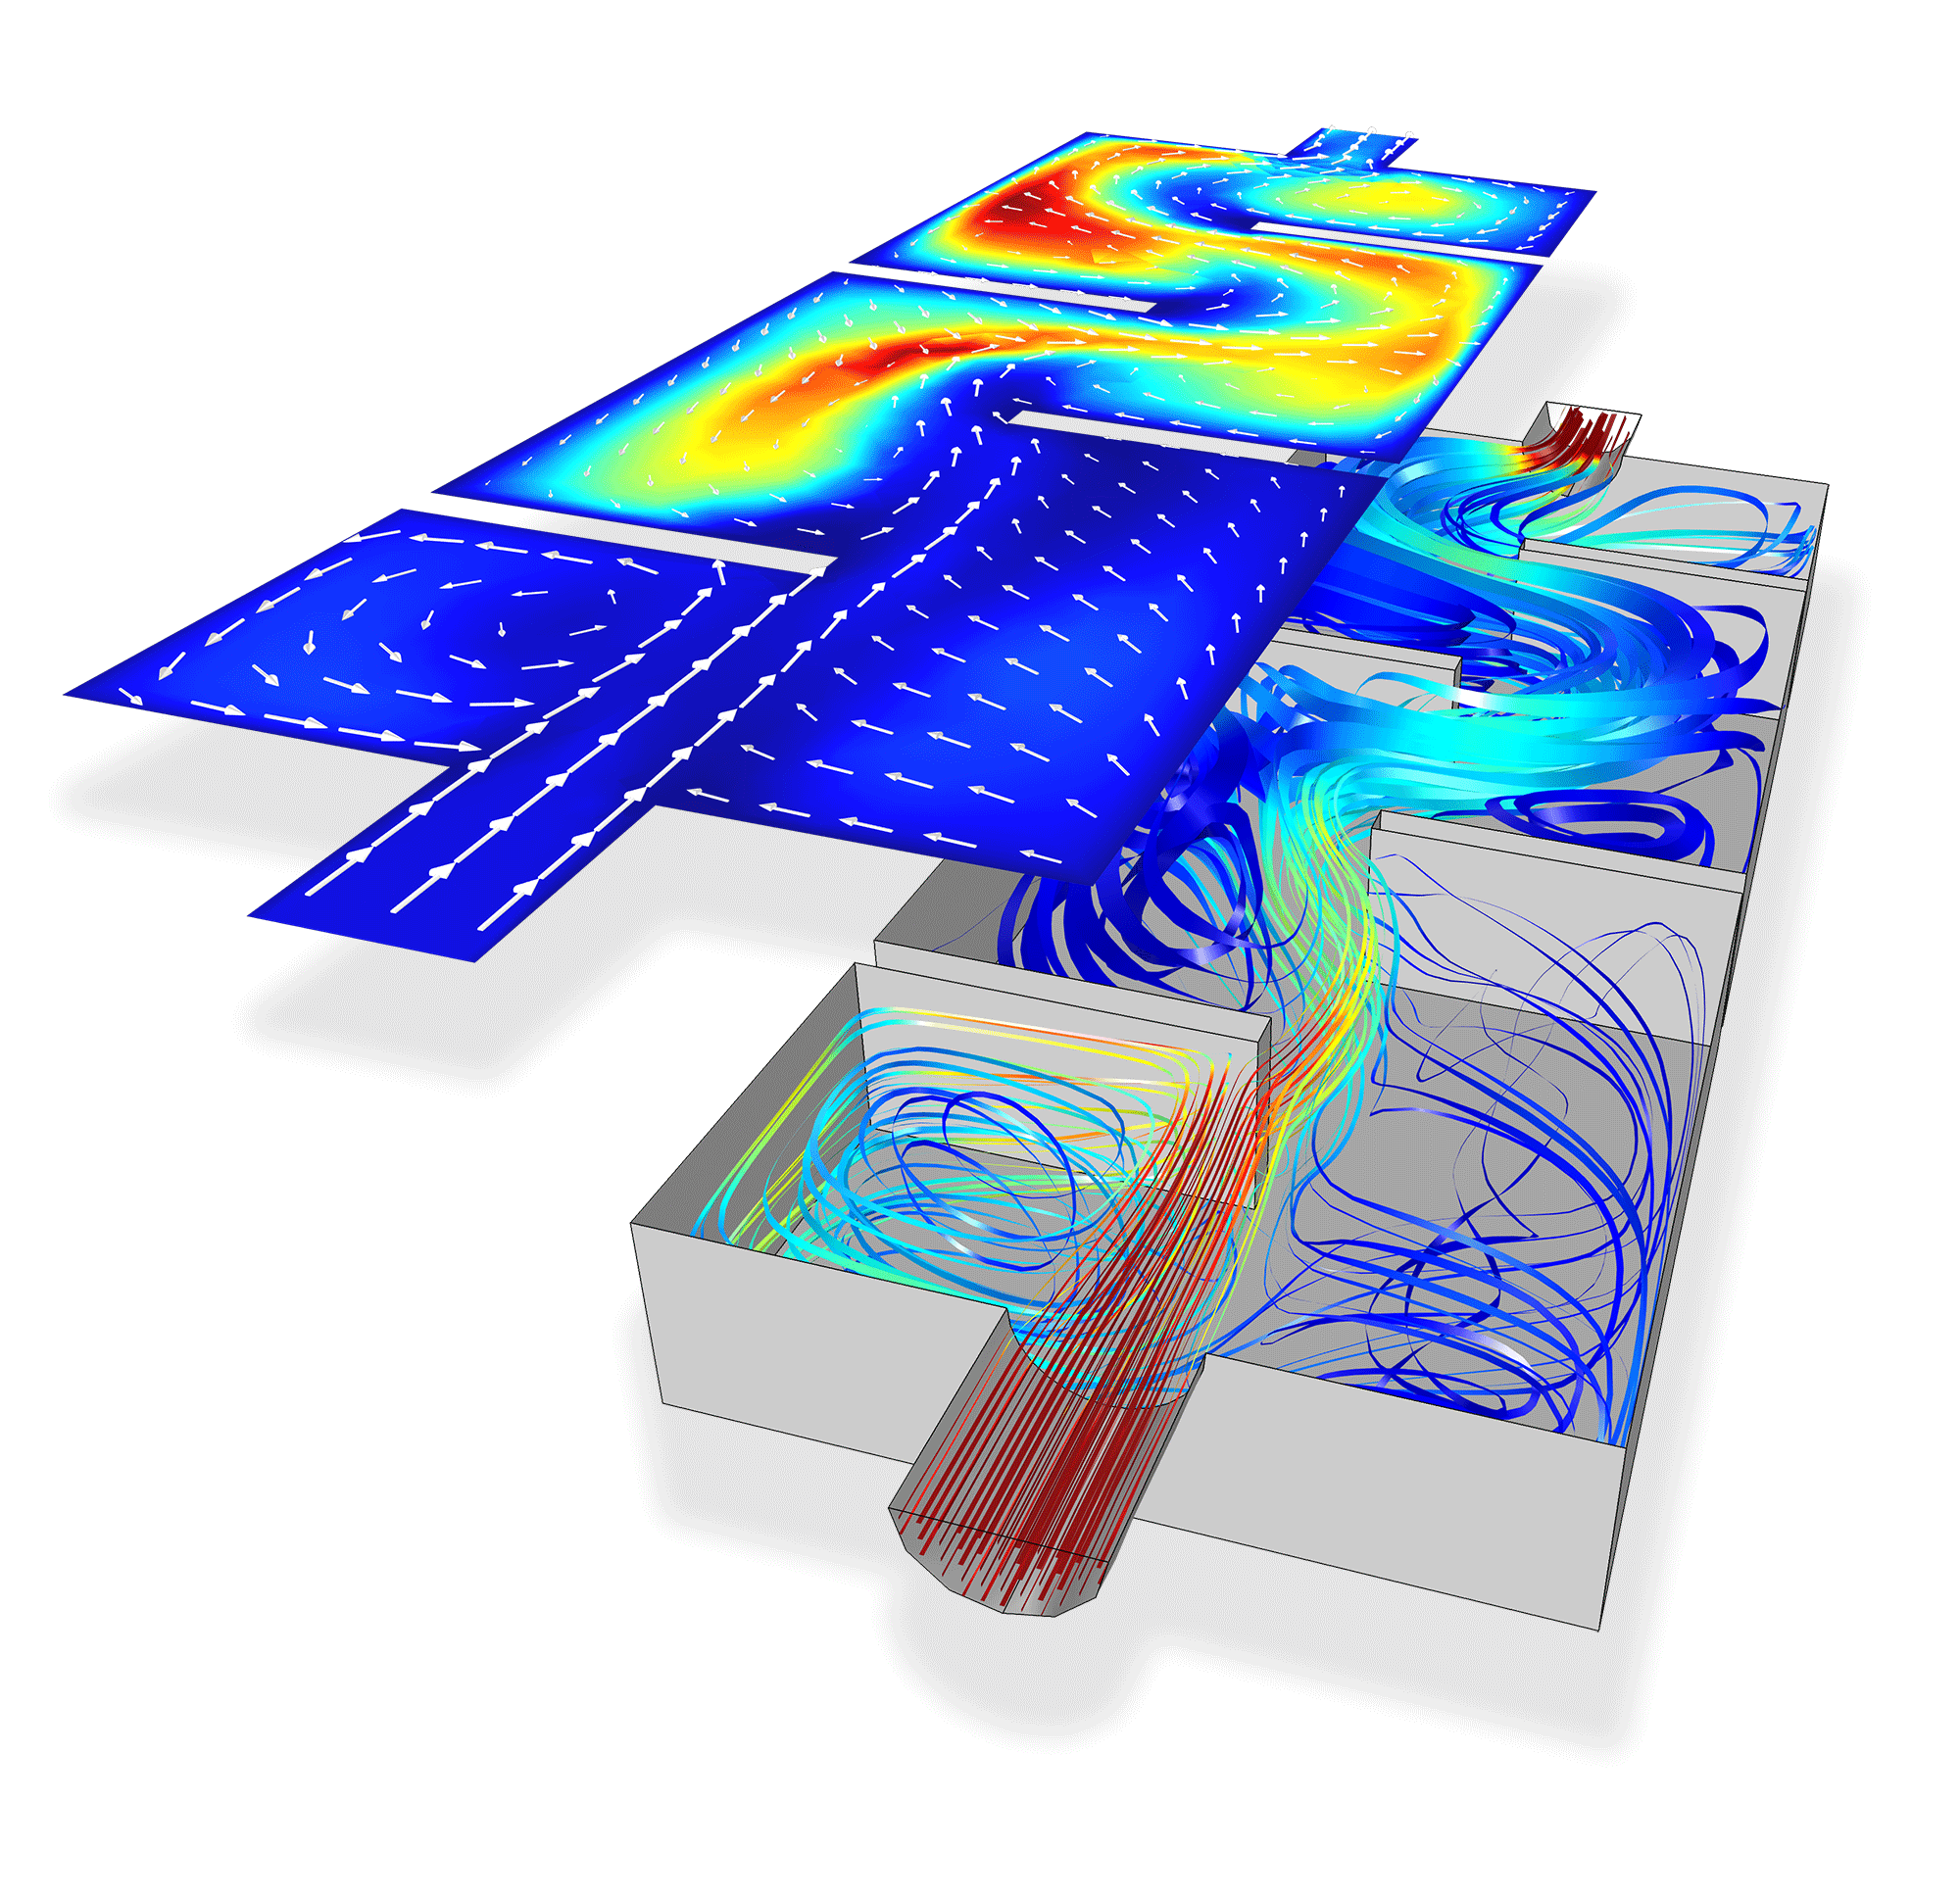
Actual Water
“I’m researching if water can spontaneously blow up” - Terence Tao
While we simulate fluid flow, we assume that fluid is a continuous density field
Water is actually made of molecules, so this assumption is not actually true
This just makes approximations to how fluid might act because simulating molecular and atomic dynamics with quantum effects is nearly computationaly impossible.

Slide 9

Bernoulli Equation
We can get Bernoulli’s Equation from Navier-Stokes
$\vec{v}∗div\left(\vec{v}\right)=\frac{1}{2}grad\left({\vec{v}}^{2}\right)−\vec{v}×curl\left(\vec{v}\right)$
$ρ\left(\frac{∂\vec{v}}{∂t}+\frac{1}{2}grad\left({\vec{v}}^{2}\right)−\vec{v}×curl\left(\vec{v}\right)\right)=−grad\left(P\right)+μ∗grad\left(div\left(\vec{v}\right)\right)+ρ\vec{f}$
Assume that the fluid flow is steady-state: $\frac{∂\vec{v}}{∂t}=0$
Non-viscous flow: $\vec{v}×curl\left(\vec{v}\right)=0$
$\vec{f}$ is force of gravity, so $ρ\vec{f}=−grad\left(ρgh\right)$
$\frac{1}{2}ρgrad\left({\vec{v}}^{2}\right)+grad\left(ρgh\right)+grad\left(P\right)=0$
$\frac{1}{2}ρΔv^{2}+ρgΔy+ΔP=0$
$\frac{1}{2}ρ{v_{1}}^{2}+ρgy_{1}+P_{1}=\frac{1}{2}ρ{v_{2}}^{2}+ρgy_{2}+P_{2}$

Slide 10

Numerical Methods
The only really reasonable way to solve these equations is using computers and numerical methods
Equations must be discretized
This is easy for equations in time like $\frac{∂\vec{v}}{∂t}$ as you can use something that looks a lot like Euler integration, updating something for each time step
The spatial derivatives, like $\frac{∂\vec{v}}{∂x}$ are not quite as obvious
One method is to store a value for variables like $\vec{v}$ for each discrete cell that breaks down the total volume
The derivative is then easily evaluated as a difference between neighboring cells in a certain direction
Accuracy becomes important as well as ensuring that the simulation does not become filled with ‘garbage’ numbers
As we are dealing with dynamic systems, blow up and stability is a problem which require careful refinements to avoid

Slide 11
Demo
https://github.com/andrew-pa/fluidynm

